Slide 1

Name | Chetan Gavali
Enrollment Number | EBEON0322584033
Batch Code | 2021-7236
Center | Pune-EXL

Slide 2
Car Price Prediction with Machine Learning

Slide 3
Objective
To Predict Car Price using various parameter like brand, fuel type, door number, engine type and many more.
In this project we also know how various parameters related to price of car.

Slide 4
Libraries Used
NumPy
Pandas
Matplotlib
Seaborn
SKlearn

Slide 5
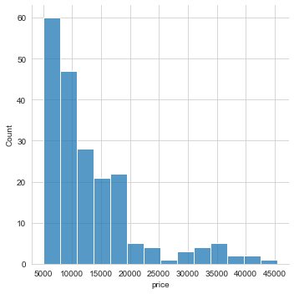
Number of Models according to Price

Slide 6
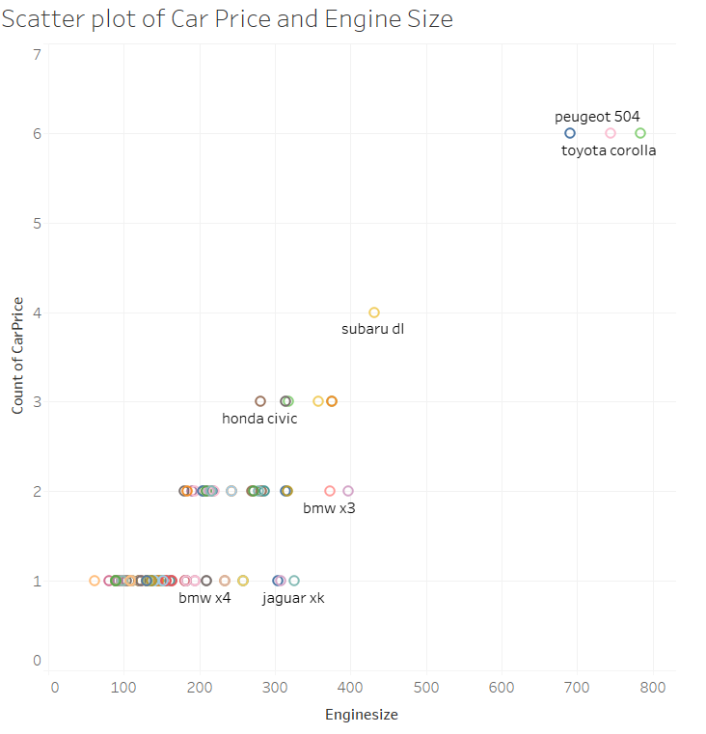
Relation of engine parameters with price

Slide 7
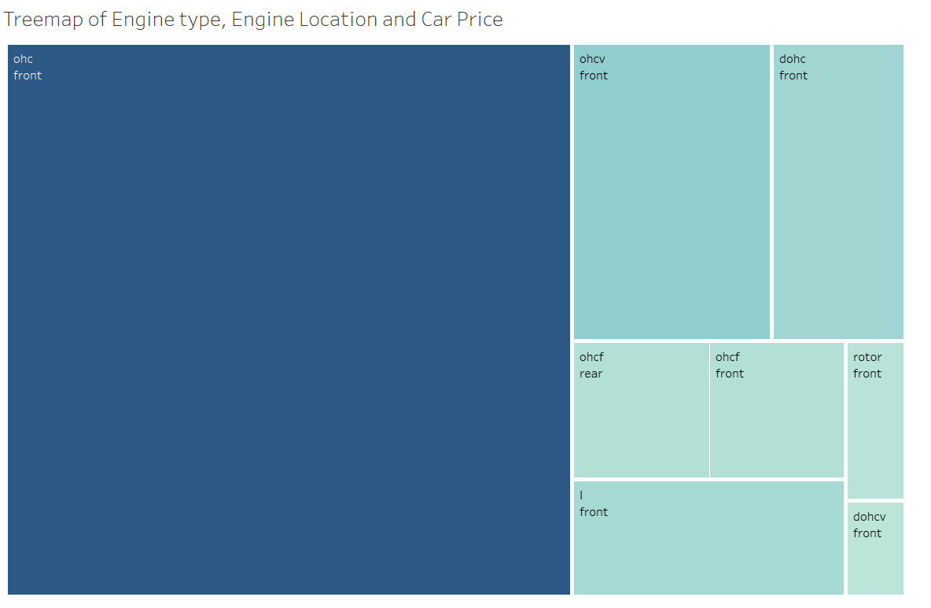

Treemap of Engine tpe, Engine location And price

Slide 8
Algorithms Used For Prediction
Linear Regression
Decision tree regression

Slide 9
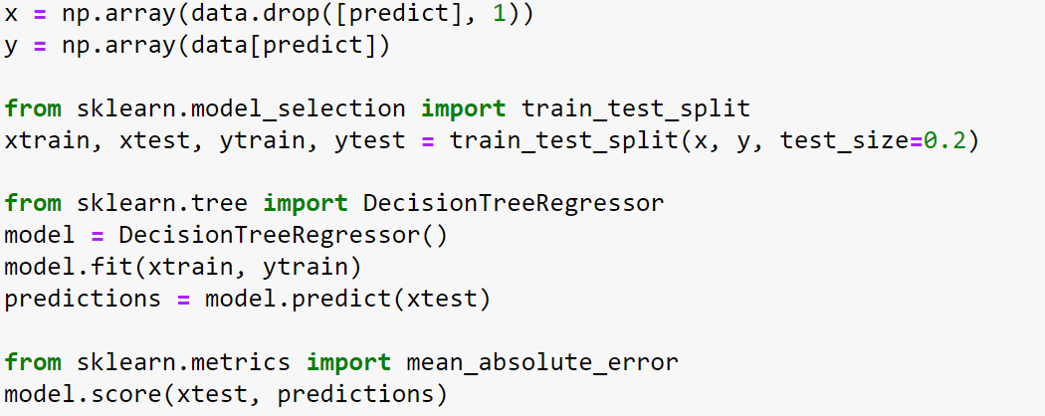
Decision tree regressor

Slide 10
To convert output into csv file
After predicting data I created csv file of test and predicted Data.

Slide 11
Conclusion
By using this predictions people can choose best car model for them.
everyone will get idea about relationship between different parameters and car price.

Slide 12
Thank You

